Slide 1
Air Quality in Marginalized Communities
By Will Munson

Slide 2
The purpose
Air pollution tends to be a serious issue in large urban environments. What makes this issue worse is poorer areas tend to have higher levels of air pollution than wealthier areas. As a result, those who live in those communities tend to be more vulnerable to various forms of cancer, respiratory problems, and even slower brain development in some children. Most studies indicate PM2.5 at or below 12 μg/m3 is considered healthy with little to no risk from exposure. If the level goes to or above 35 μg/m3 during a 24-hour period, the air is considered unhealthy and can cause issues for people with existing breathing issues such as asthma. For this, I will be taking a closer look at the average Fine Particulate Matter (PM2.5) levels from 2008 to 2020, and see how they correlate with New York City’s demographics for each year.

Slide 3
Tools and Packages
Started with two Excel spreadsheets
R Studio was used to load and manipulate the data
Packages used:
Tidyverse - filtering and removing unnecessary fields
Lubridate - changing values from char to date
Ggplot2 - proper visualizations
Broom - used for obtaining numeric values for Cook’s Distance and residuals

Slide 4
Datasets used
Air Quality data obtained from data.gov for New York City
NYU Fuhrman Center Demographic Data for New York City, broken down by boroughs, Public Use Measurement Area, and community district

Slide 5
Roadblocks and Issues
One of the biggest issues with this dataset is the fact that none of the most basic demographic data was filled in for areas broken down by community district.
Had to copy and paste data for population density from the PUMA data into their corresponding districts, meaning some districts had to have matching numbers for density (example, Manhattan districts 1 & 2)

Slide 6
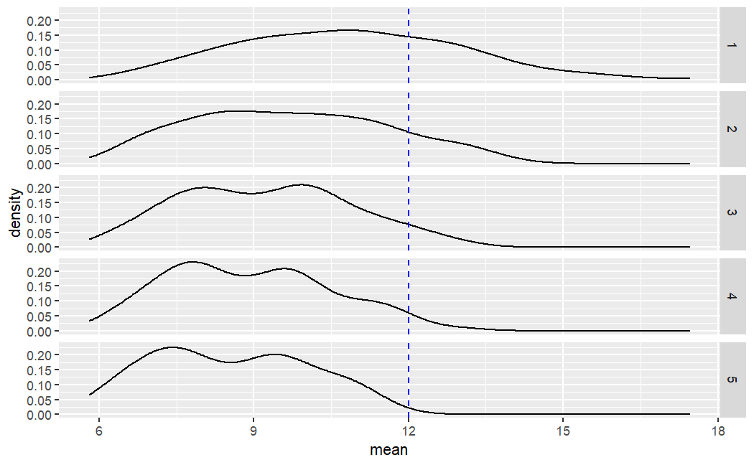
Distributions
The averages for every district each year, from 2008 to 2020.

Slide 7
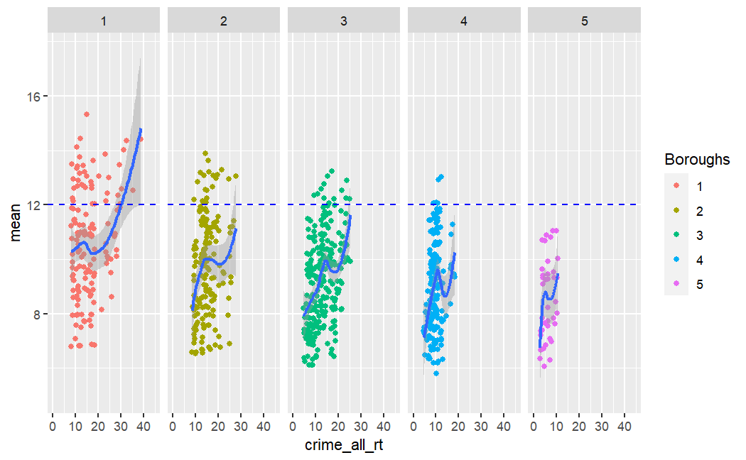
Mean pollution VS. Crime
The Five Boroughs:
Manhattan
The Bronx
Brooklyn
Queens
Staten Island
As shown on the graph, most areas of Manhattan and the Bronx appear to be above 12 ppm on average. In addition, neighborhoods with higher crime also appear to have higher levels of PM2.5.

Slide 8
The variables
While the initial dataset had a combined total of 124 variables, only one third of them contained data, which was then whittled down to a total of 17 variables. Many of these were excluded due to lack of useful data (proximity to a park or subway), or did not have enough significance for the linear model.

Slide 9
Factors used in our linear model
Mean Response variable - Yearly mean PM2.5 levels
Crime_all_rt Total crime rate
Hpi_al Average price changes for all homes
Lp_all total number of properties that had mortgage foreclosure actions initiated against them.
med_r_4f Median rent for 2-4 family homes
med_r_ot Median rent for multifamily buildings
nb_permit_res_units Total units authorized by new residential building permits
pct_prof_ela Percent of students (4th grade or below) performing at or above grade level in the arts/english
Pfn_fam14condo Total pre-foreclosure notices issued to homeowners of 1-4 family homes
pfn_fam14condo_rate Rate of pre-foreclosure notices issued to homeowners of 1-4 family homes
priv_evic_filing_rt Eviction filings per rental unit
priv_evic_filings Total eviction filings
total_viol_rate Total housing violation rates
volume_1f Amount of transactions made towards 1 family homes
volume_4f Amount of transactions made toward 2-4 family homes
Volume_al Amount of transactions made toward all properties
Population_density Population density per square mile (copied and pasted from the PUMA data)

Slide 10
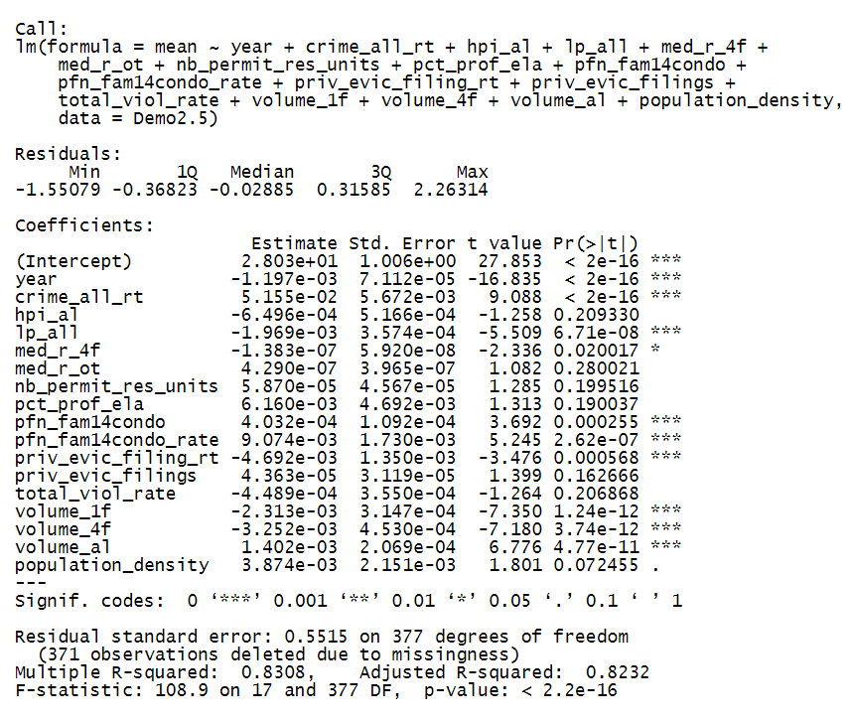
Starting Results
Before beginning the data cleaning process, I had to find a linear model that would be most fitting for the dataset, then used Cook’s Distance to outline where there were outliers

Slide 11
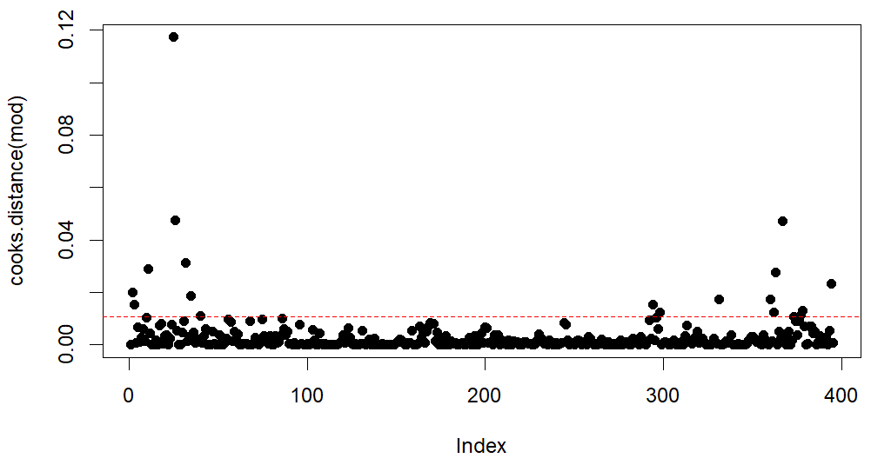
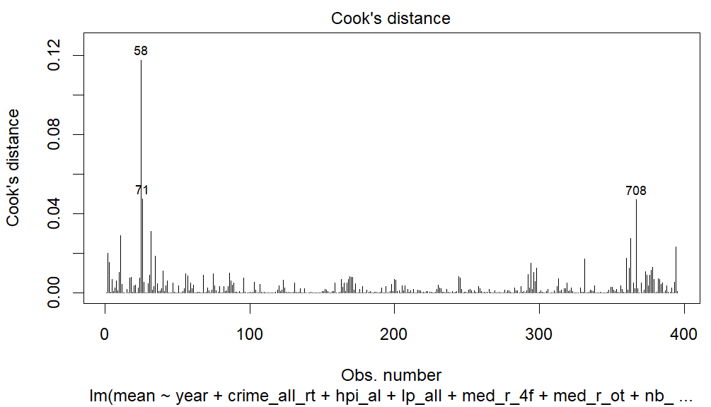
Outlier tests - Cook’s Distance
First Cook’s Distance test - quite a few outliers
Point 58 - Midtown in 2013
Point 71 - Stuyvesant Town/Turtle Bay in 2013

Slide 12
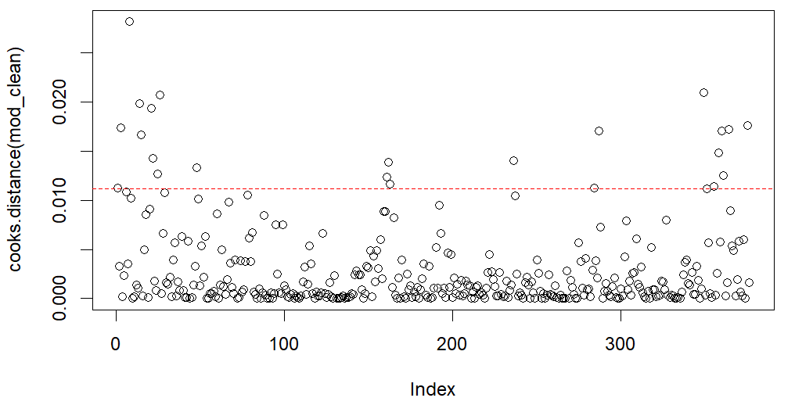
Cleaning process
Test 2 - Reduced the number of points from 395 to 376. This will probably be a good stopping point

Slide 13
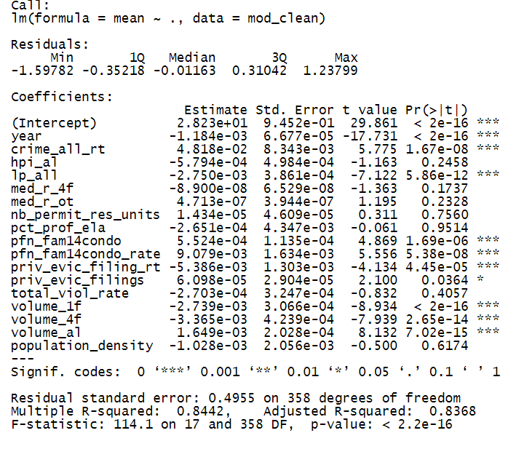
Cleaned Model
After cleaning the model, we find that the number of transactions towards homes have much higher significance, and foreclosure actions have higher significance. Meanwhile, number of permits, academic performance and even population density appear to be obsolete.

Slide 14
Improvements from data cleaning
Multiple R-Squared increased from 0.8308 to 0.8442
Adjusted R-Squared increased from 0.8232 to 0.8368
Standard Error reduced from 0.5515 to 0.4955

Slide 15
Conclusions
Judging by the results, we can indeed conclude that air pollution appears to be more of a problem in areas where crime is high, housing is more troubling, and people are less inclined to even buy/rent a home.

Slide 16
Works Cited
Air Quality. .xlsx, https://data.cityofnewyork.us/api/views/c3uy-2p5r, data.cityofnewyork.us, 11 Apr. 2022, https://catalog.data.gov/dataset/air-quality.
McNally, Charles. CoreData.Nyc Data Profile. .xlsx, 20 Dec. 2022, https://furmancenter.org/coredata/userguide/methodology.
Fine Particles (PM 2.5) Questions and Answers. June 2023, https://www.health.ny.gov/environmental/indoors/air/pmq_a.htm.

